Slide 1
A Deep Dive Into IT Job Trends
CA1
ST1510 Programming for Data Analytics - CA1
Done By: Balamurugan Siddhartha DAAA/FT/1B/07 (P2404312)

Slide 2
01
Background Information
& Research
02
Exploratory Data Analysis (EDA) & Data Wrangling (Pandas)
03
Data Visualisation With MatPlotLib
04
Conclusions To My Crafted Research Question

Slide 3

Research Question
How do IT-related job postings vary across geographic locations in terms of hiring trends, salary ranges, required skills, experience levels, and work types?

Slide 4
Datasets Provided
Before starting the assignment, I skimmed through the provided datasets to get an initial understanding of the data quality, including the extent of missing values and the range of variability in the data. I also inspected the columns to gain better clarity. To ensure accurate results for my research question, I aimed to identify potential trends and get an overall sense of the number and structure of the columns.
Dataset Provided | Brief Understanding
postings1.csv | Contains job postings with company names, job titles, and unique job IDs, requiring cleaning of missing company names.
postings2.csv | Includes job descriptions, max salary, and job IDs, highlighting the need for salary distribution analysis and text cleaning.
postings3.csv | Offers data on pay periods, job location, salary metrics, and views for job postings, requiring handling of missing salary values and engagement analysis.
postings4.csv | Provides detailed metadata for job postings, including application types, timestamps, work types, and missing data points for better application trend analysis.
postings5.csv | Features job postings with company names, titles, and irrelevant/unimportant columns, requiring removal of unnecessary data for focused analysis.

Slide 5
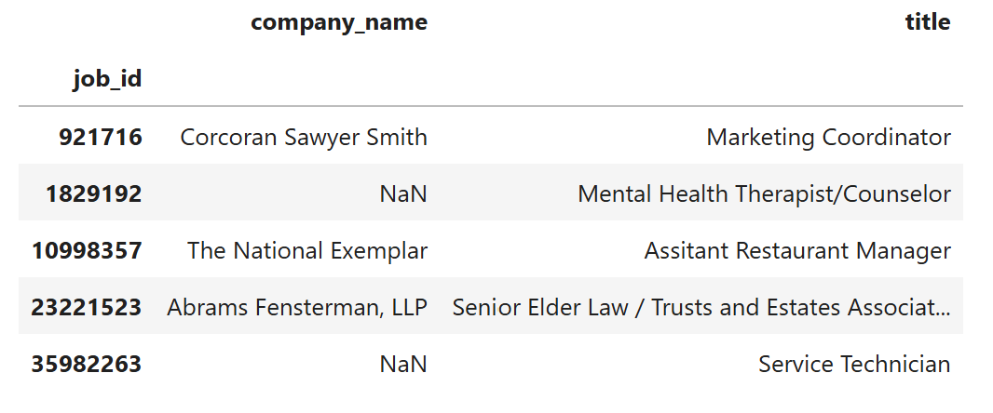
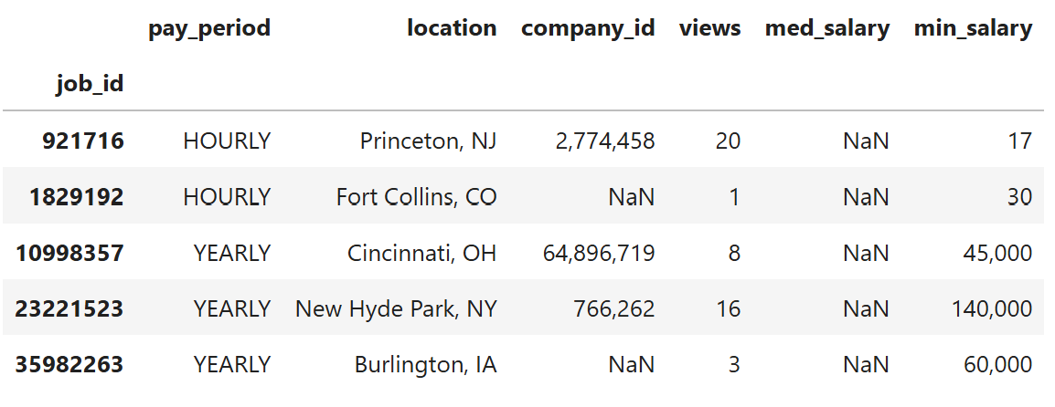
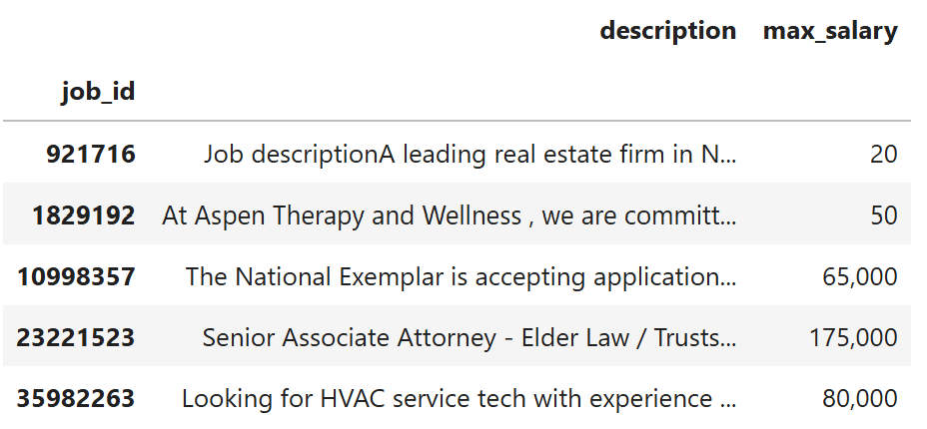
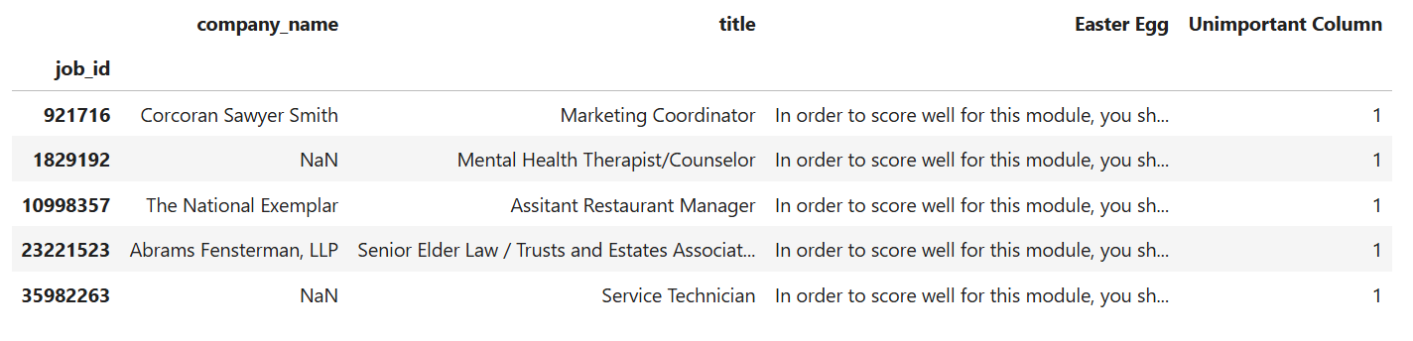
Background Information
postings_4
This assignment involved analysing a dataset of job postings to uncover meaningful patterns and trends in the job market. The dataset included attributes such as job titles, salaries, locations, work types, and application counts, as mentioned in the earlier slide.
postings_1
postings_3
postings_2
To carry out this analysis, I will be using Pandas for data manipulation and Matplotlib for data visualisation.
The context centers around an intern, Alex, who discovered a forgotten USB drive containing valuable job data. Tasked by the CEO, Alex analysed this information to uncover trends and explore the popularity of various job postings.
postings_5

Slide 6

Exploratory Data Analysis & Data Wrangling With Pandas
Let’s Dive In & Analyse The Dataset!

Slide 7
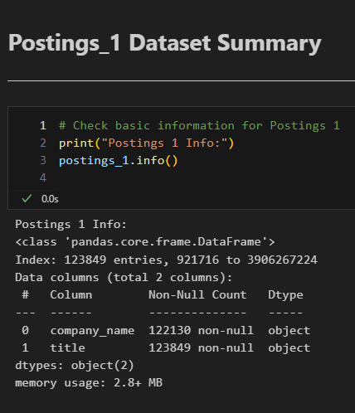
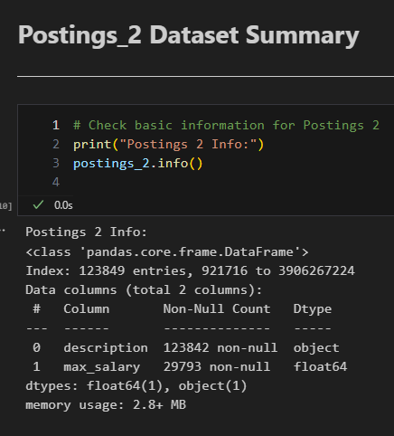
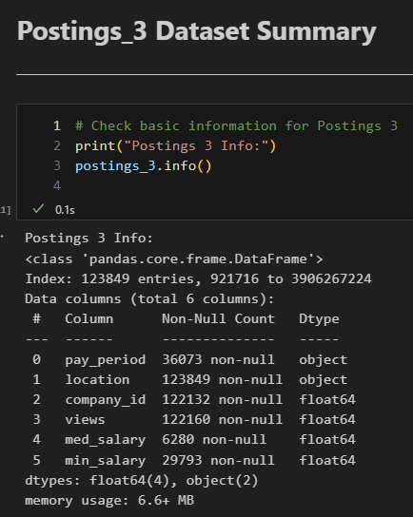
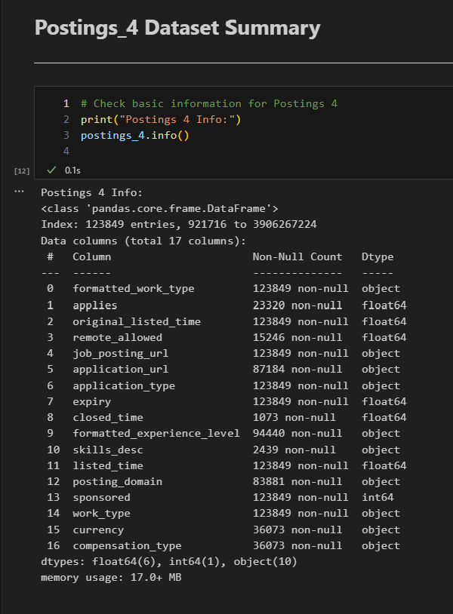
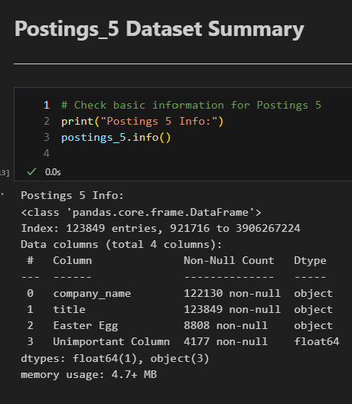
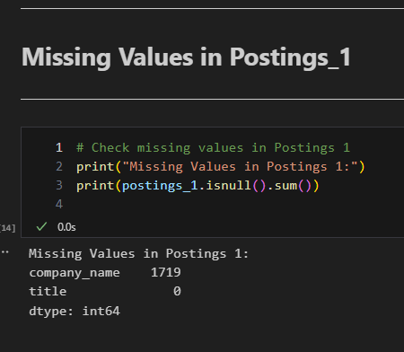
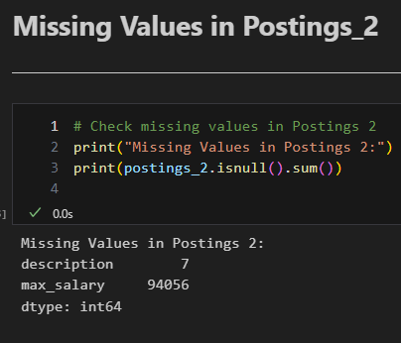
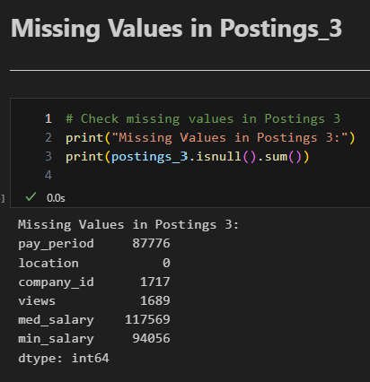
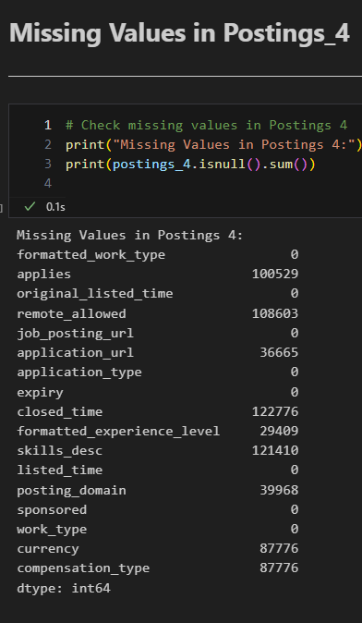
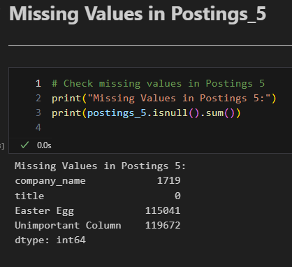
Individual Data Exploration : Structure & Missing Values
.info() on each dataset
Check for missing values !
The .info() method provided a quick and efficient way to understand the structure and quality of the datasets. It revealed essential details such as the number of columns, non-null counts, data types, and memory usage for each dataset.
Dataset | Columns | Missing Data | Memory Usage | Key Actions
Postings_1 | company_name, title | Minimal (<1%) | 2.8 MB | Ready for direct analysis.
Postings_2 | Description, max_salary | max_salary: ~76% | 2.8 MB | Impute or filter missing salaries.
Postings_3 | location, views, salaries | Salary cols: ~76% | 4.6 MB | Clean salary data, verify location.
Postings_4 | 17 columns (e.g., job_level) | Varies (low-high) | 17.6 MB | Focus on key features; address redundancy.
Postings_5 | Easter Egg, Unimportant Col | Easter Egg: ~92% | 4.7 MB | Revised version of Postings_1 with extra columns; can be removed

Slide 8
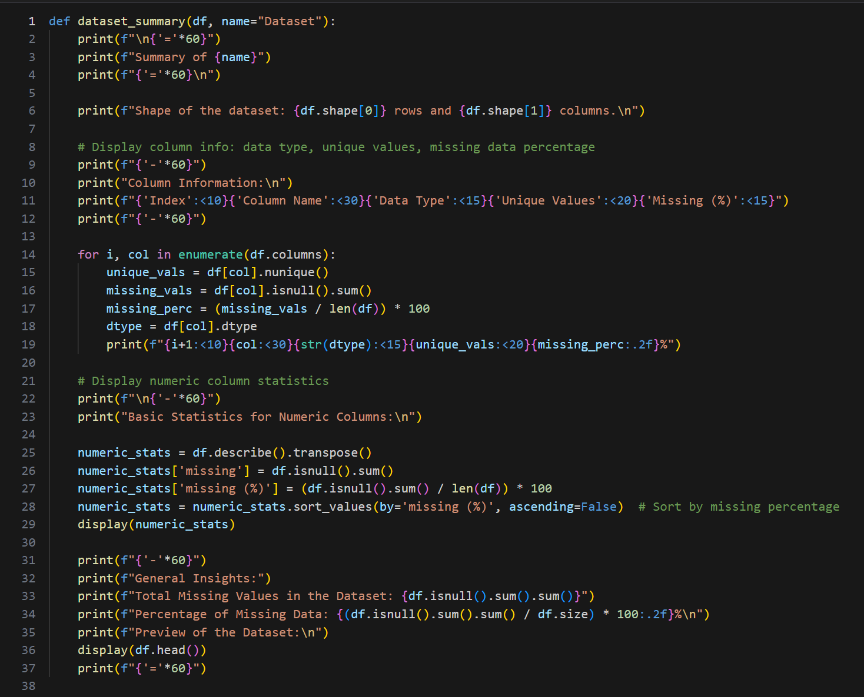
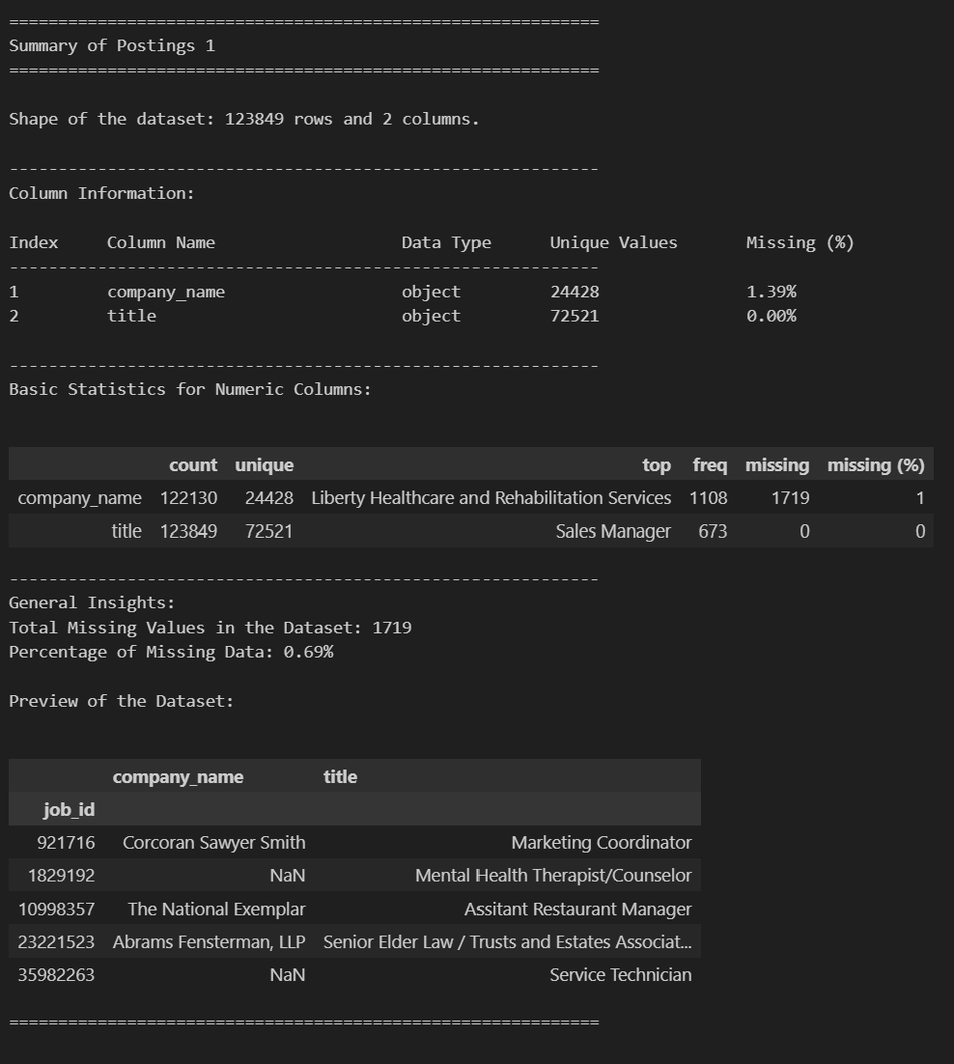
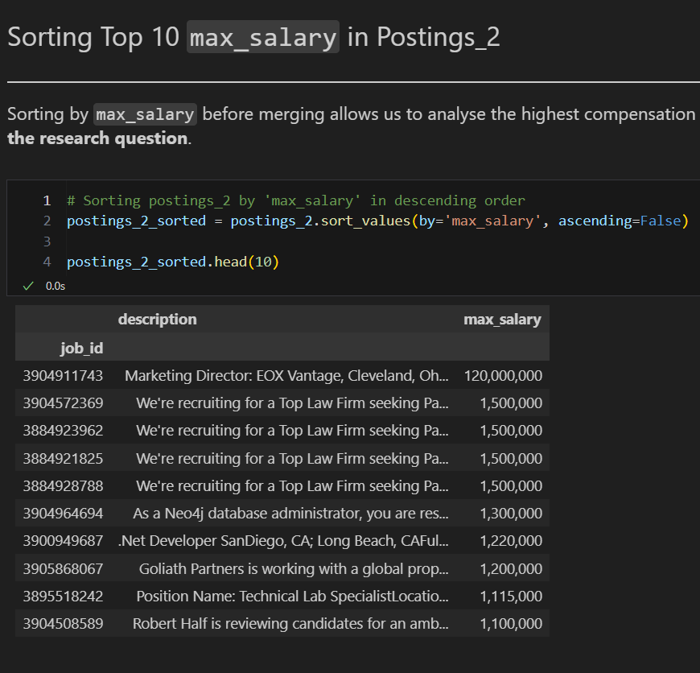
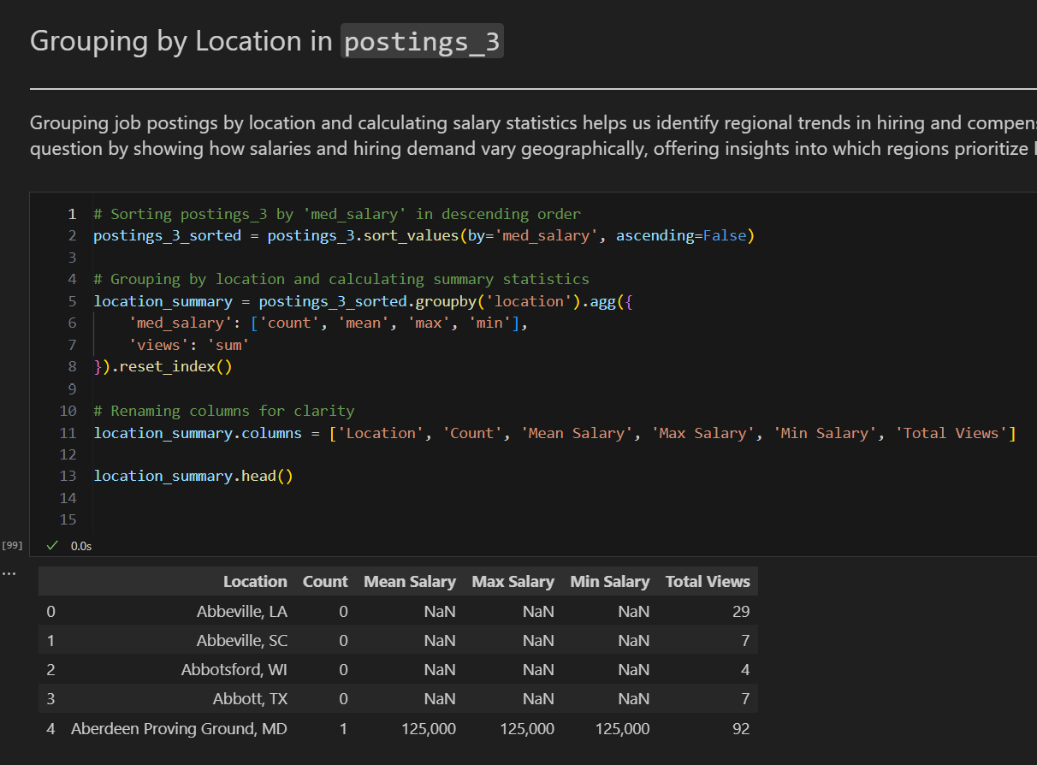
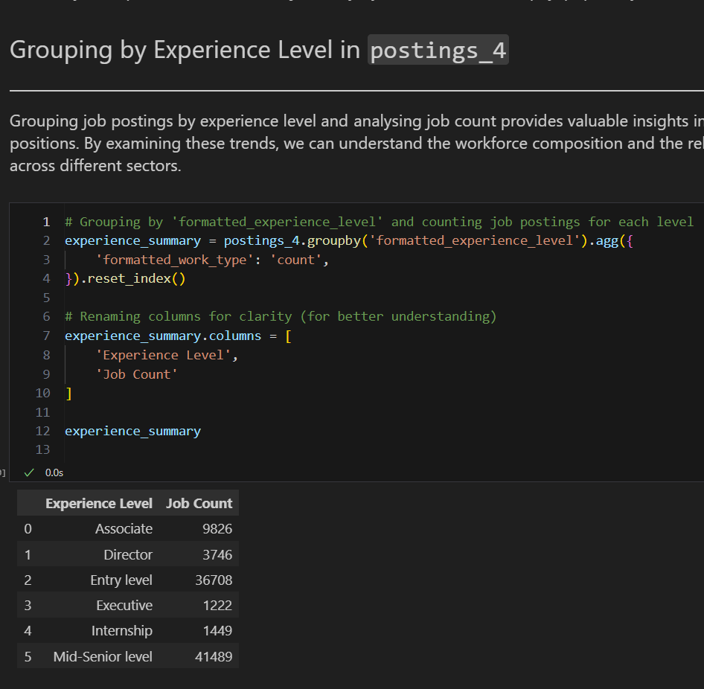
Comprehensive Data Analysis & Sorting Datasets
I created a Python function, dataset_summary(), to quickly and effectively analyse datasets. It provides essential information, including the dataset's shape, column details like data types, unique values, and missing percentages, along with basic statistics for numerical columns. The function also identifies and sorts columns by missing data and includes a preview of the dataset for better understanding. This tool helps streamline the exploratory data analysis process, ensuring I can make informed decisions for data cleaning and transformations.
Sorting the data helped prioritize key information for analysis and visualisation. By organizing top salaries, regional trends, and job distributions in descending order, it became easier to highlight patterns, such as the highest-paying roles, geographic hiring hotspots, and workforce demand by experience level. This improved clarity and made visualizations more impactful and actionable.
Sorting Top 10 max_salary in Postings_2
Grouping By Location in Postings_3
Grouping By Experience Level in Postings_4

Slide 9

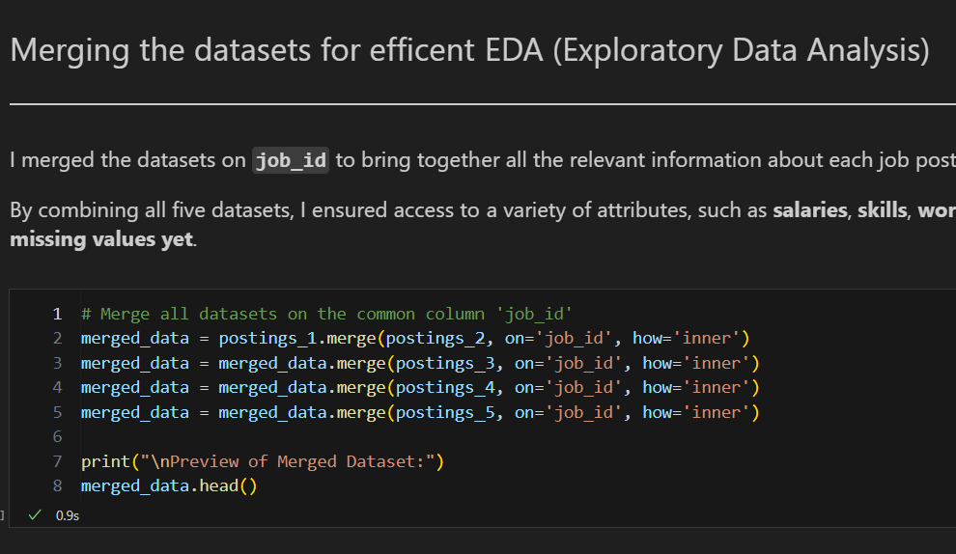
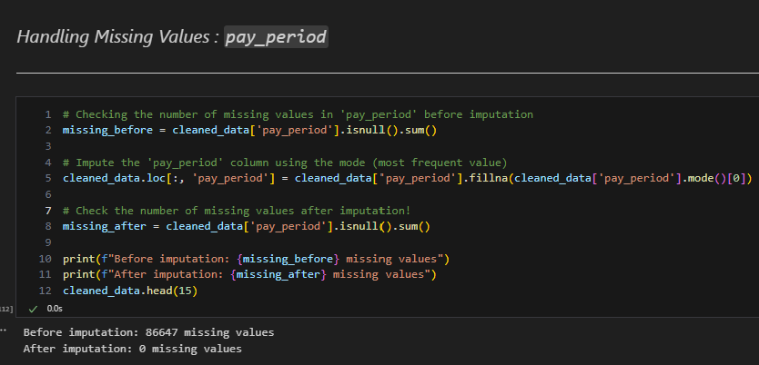
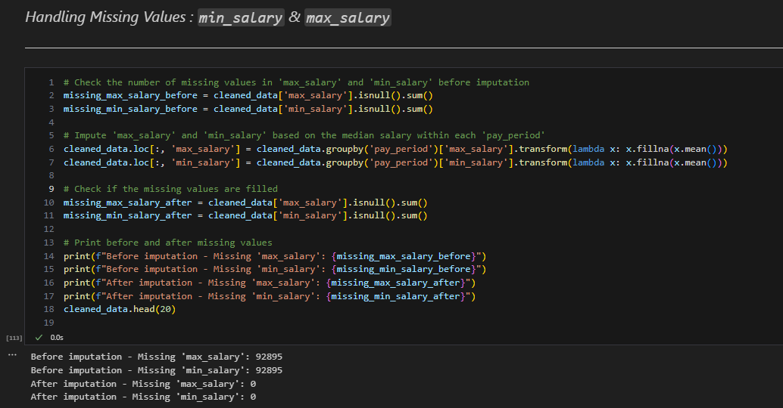

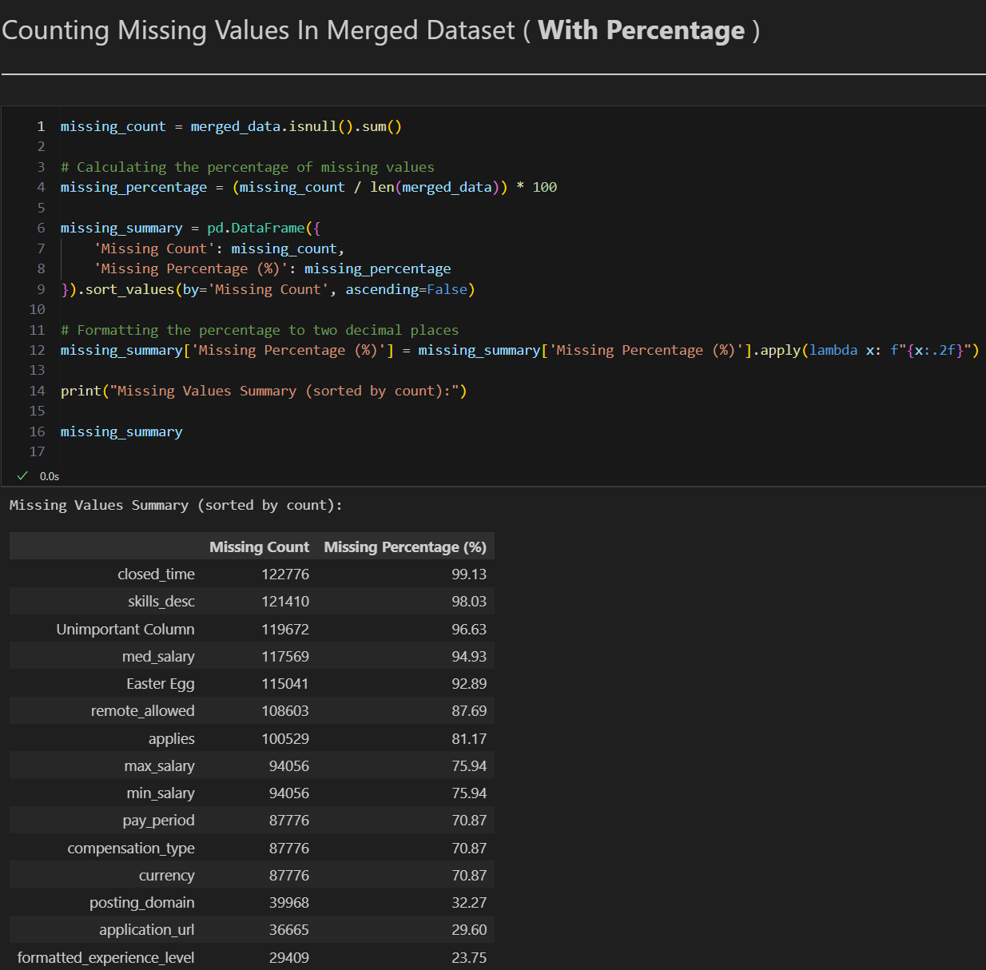

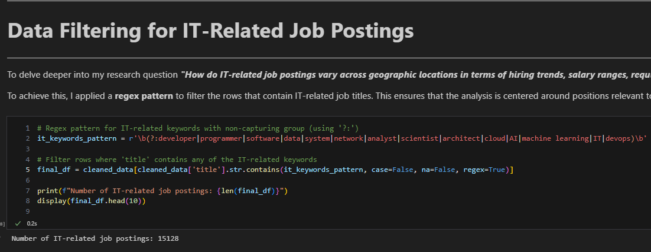

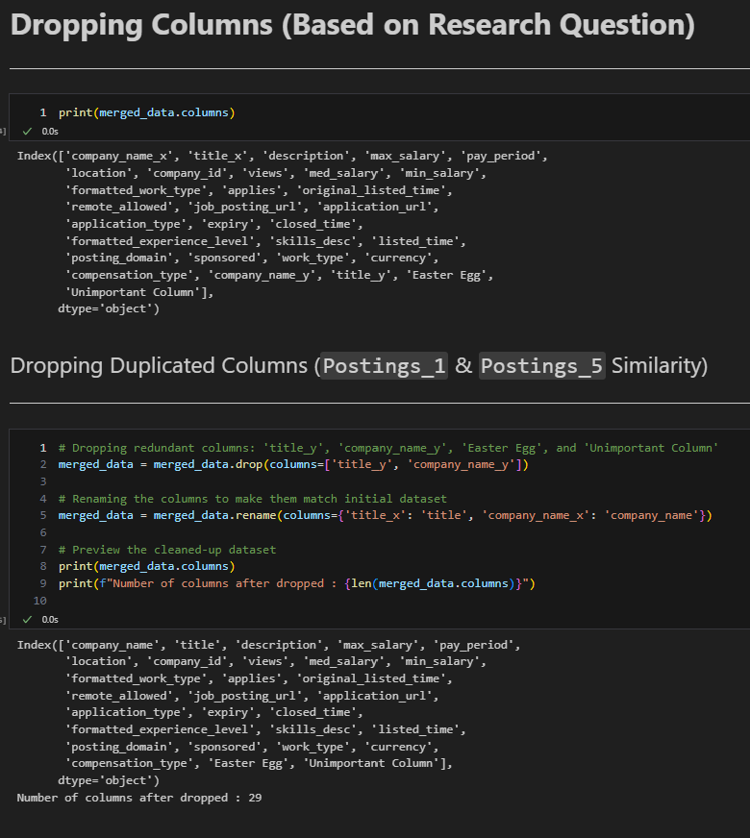
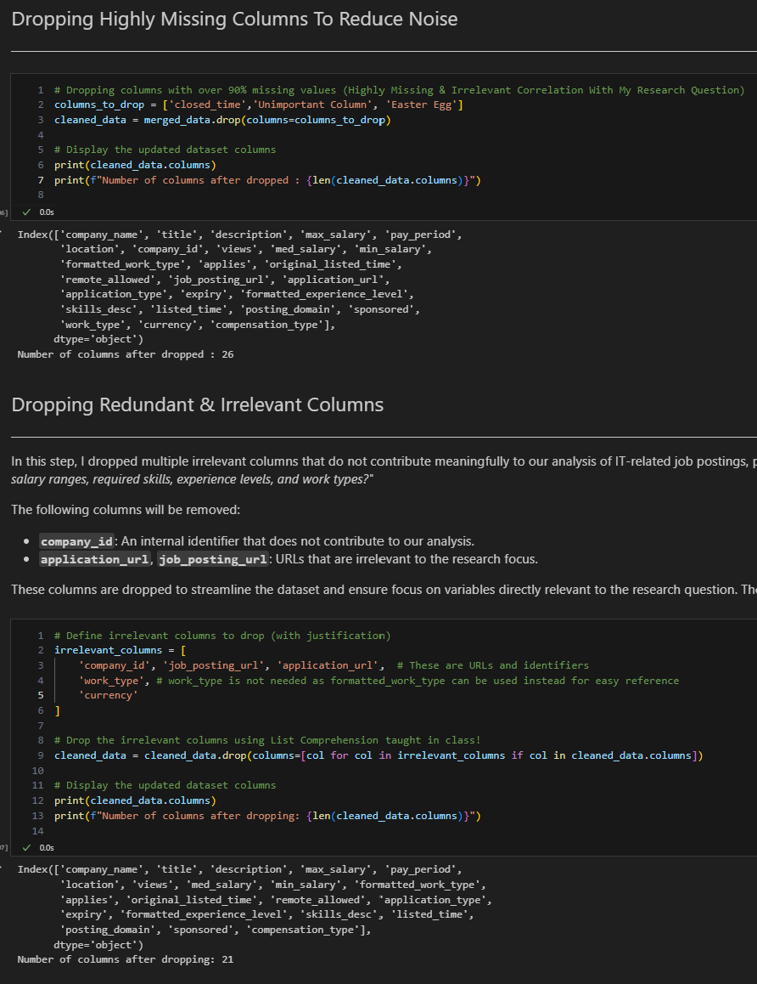
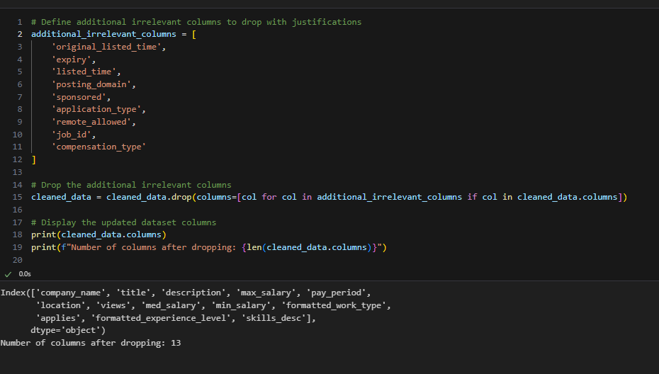
Data Wrangling: Merging & Cleaning
Merging Datasets
Imputation & Handling Missing Values
Firstly, I merged the datasets using an "inner join" to combine relevant information for clearer analysis. This approach helps identify and strategise handling missing values while preparing a comprehensive dataset for efficient EDA and visualisation.
To handle missing values, I imputed pay_period using the mode for consistency and used group-based means within pay_period for max_salary, min_salary, and med_salary to maintain logical salary trends. Missing description and company_name entries were filled with placeholders like "No description available" and "Unknown Company." For formatted_experience_level, the mode was used, while skills_desc was filled with "No skills listed." Medians were applied for applies and views to retain data integrity, ensuring a clean dataset for accurate IT job trend analysis.
I reviewed missing values to decide which columns to remove or fix. Columns with over 90% missing data, like closed_time and Easter Egg, will be removed unless they’re essential (e.g., skills_desc). For columns with 70%-90% missing values, like max_salary and remote_allowed, I’ll either remove or fill in the gaps depending on their importance. Columns with 20%-50% missing data will be kept and cleaned, while those with under 5% missing (e.g., company_name_x and company_name_y) will be combined to avoid duplication. This ensures the dataset is tidy and relevant for analysis.
Lastly, I used a regex pattern to filter IT-related job titles like "developer" and "data," ensuring the analysis focused on IT roles relevant to my research question.
This is the end of My Pandas Data Analysis!
Regex Matching
Dropping Columns
I refined the dataset by dropping redundant, irrelevant, and highly missing columns to streamline analysis and focus on the research question. Duplicates like title_y and company_name_y were removed, and columns with over 90% missing data (e.g., Easter Egg, closed_time) were dropped unless essential. Irrelevant attributes such as URLs, job IDs, and platform-specific details were excluded as they didn’t contribute to hiring trends, salaries, or skills analysis. This process reduced the dataset to 13 relevant columns, ensuring clarity and alignment with the research objectives.

Slide 10
Final DataFrame Overview
Column Name | Description | Relevance to Research Question
company_name | Name of the company posting the job | Identifies key employers and hiring trends across regions.
title | Job title of the posting | Focuses on IT-related roles to filter and analyze trends.
description | Detailed description of the job | Provides insights into required skills and responsibilities for IT roles.
max_salary | Maximum salary offered for the role | Used to analyse salary ranges geographically.
pay_period | Salary frequency (e.g., hourly, yearly) | Helps compare salaries across different locations and roles.
location | Geographic location of the job posting | Core to identifying regional hiring trends.
views | Number of views on the job posting | Indicates interest/popularity of job roles by location.
med_salary | Median salary of similar roles | Complements max_salary to provide a comprehensive view of salary trends.
min_salary | Minimum salary offered for the role | Helps compare salary ranges for IT roles.
formatted_work_type | Work arrangement (e.g., full-time, part-time) | Highlights employment trends in terms of work types.
applies | Number of applications received | Reflects the demand for IT roles across different regions.
formatted_experience_level | Experience level required for the role | Explores trends in experience requirements geographically.
skills_desc | Required skills for the role | Identifies skill demands for IT roles and how they vary regionally.

Slide 11

Data Visualisation With MatPlotLib
Let’s Visualise The Data To Answer Our Research Question!

Slide 12
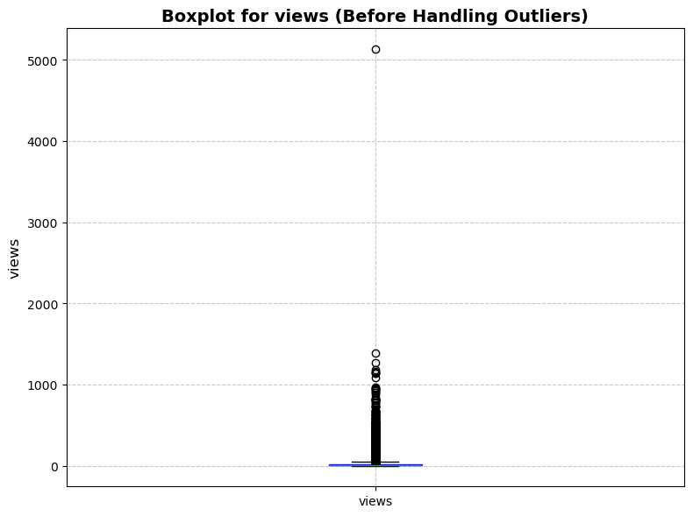
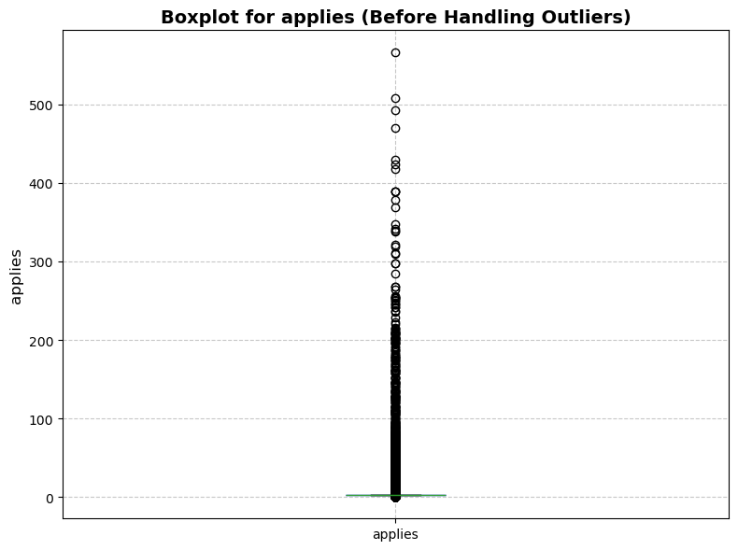
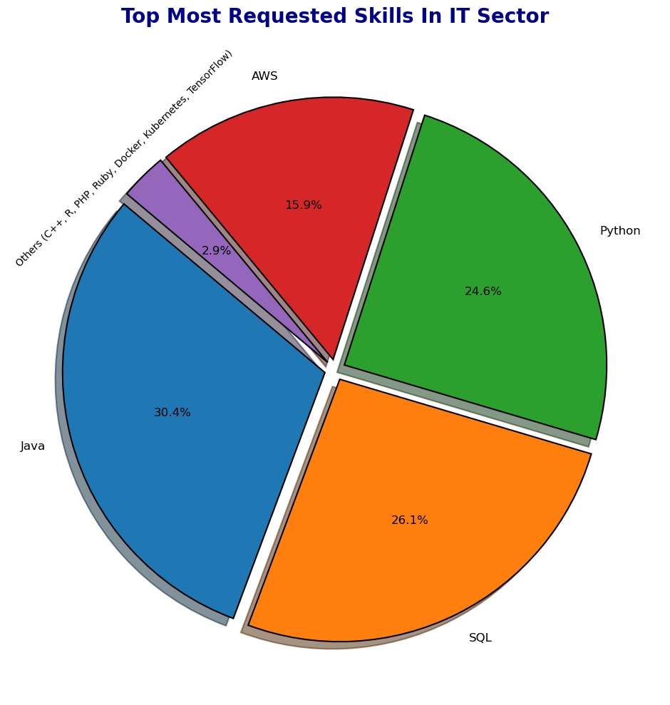
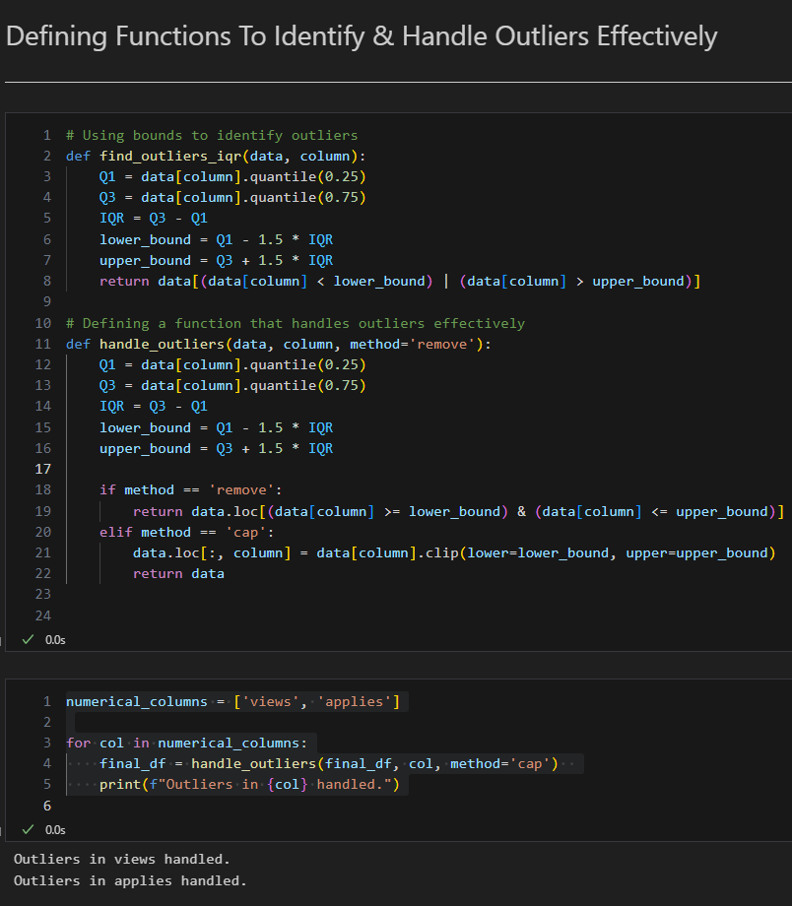
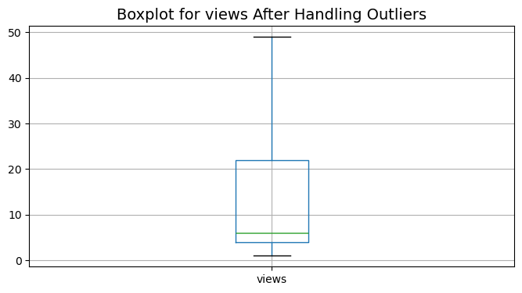
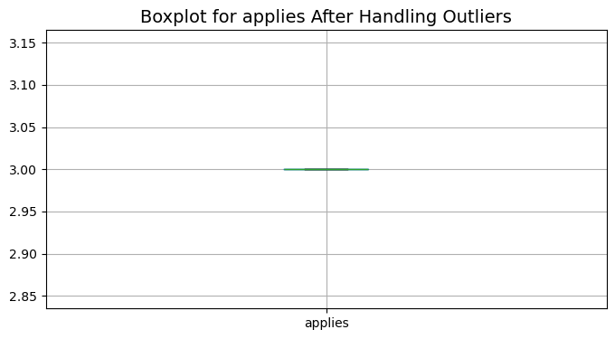
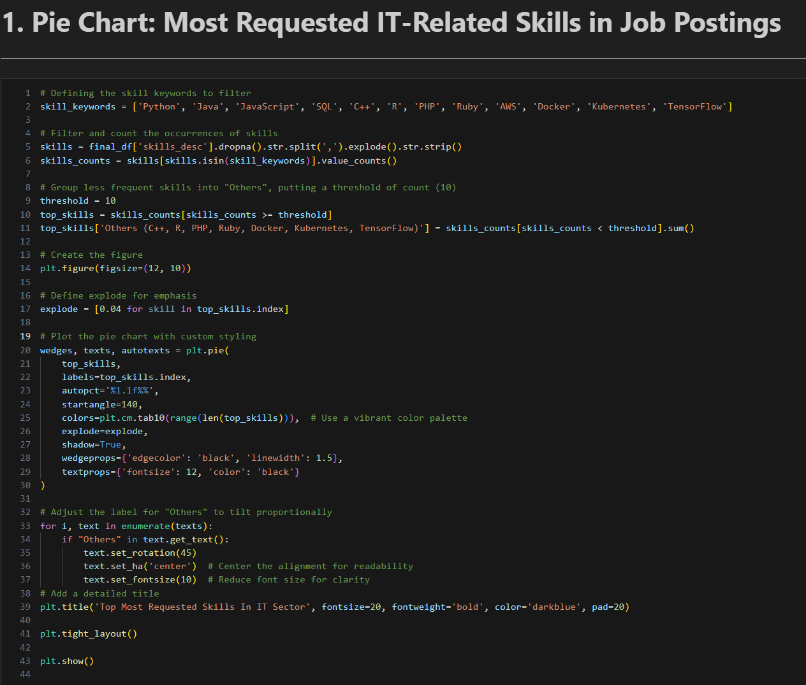
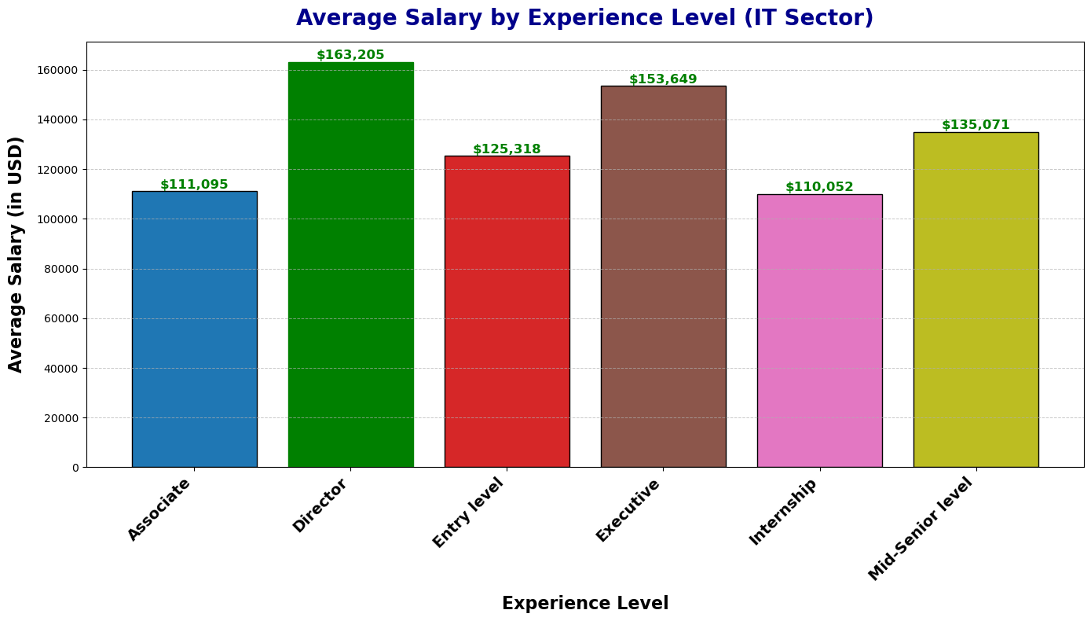
Data Visualisation: Pie Chart & Bar Chart
Handling Outliers
Pie chart of Most Requested IT-Related Skills in Job Postings
I handled outliers in the views and applies columns using the IQR method, applying capping to bring extreme values within bounds. Updated boxplots showed no visible outliers, ensuring clean and reliable data for further analysis.
In this analysis, I identified the most requested IT-related skills in job postings by filtering and cleaning the skills_desc column to focus on predefined keywords like Python, Java, and SQL. Using a pie chart, I visualised the demand, showing Python as the most in-demand skill, followed by Java and SQL. Less common skills, grouped as "Others," included technologies like C++, R, and TensorFlow. This approach simplified the data, highlighted key trends in employer priorities, and provided insights to guide job seekers and educators in focusing on high-demand skills.
Outliers Detected!
This bar chart allowed me to analyse the average salaries across different experience levels in the IT sector. I observed that higher experience levels, such as Director and Executive roles, command significantly higher salaries, while entry-level and internship positions have lower averages. This analysis helped me understand how salary expectations change with experience and supports my research question by showing how salary ranges vary across roles, providing valuable insights for job seekers and recruiters in the IT industry.

Slide 13
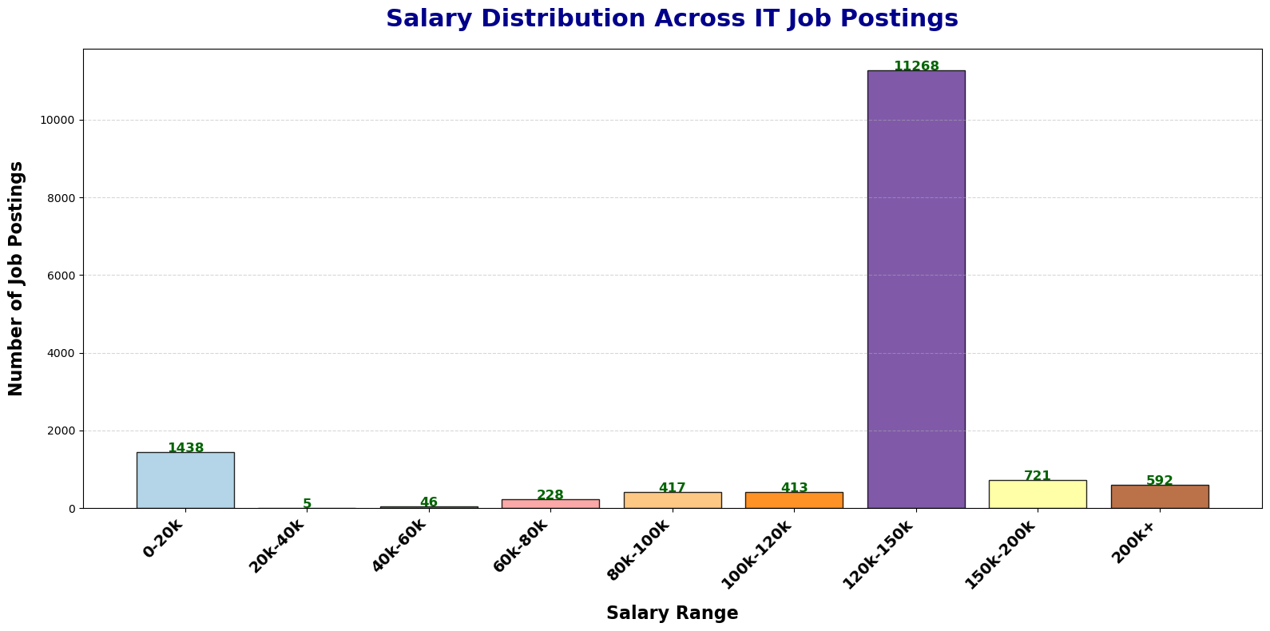
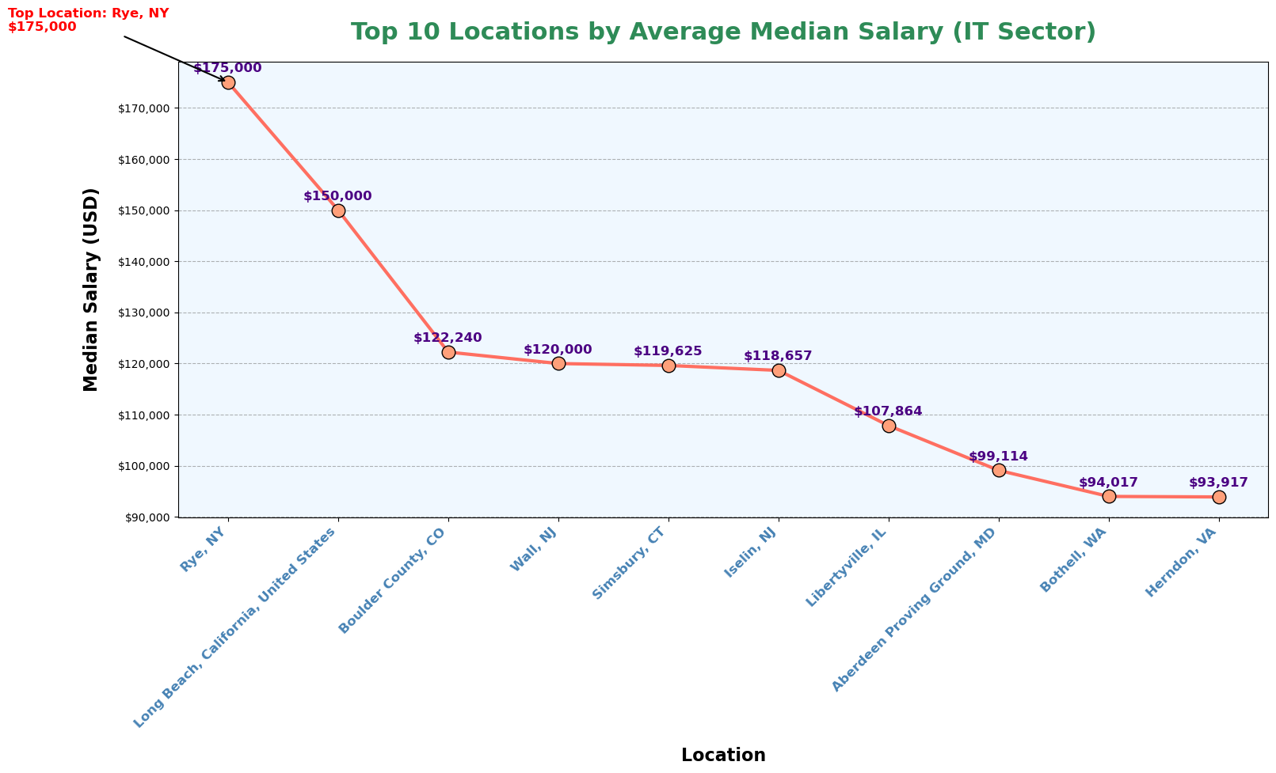
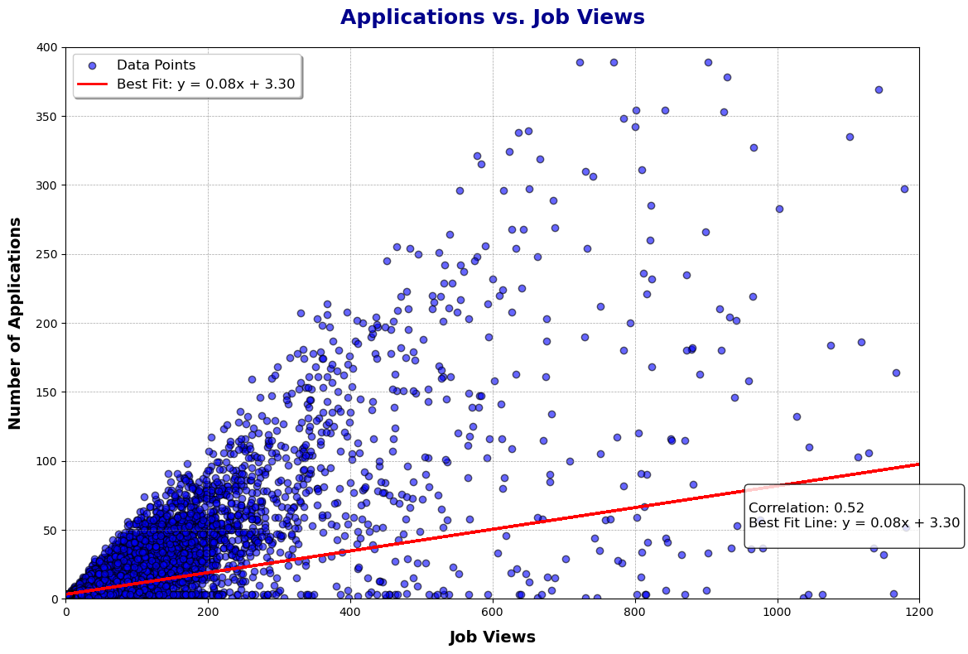
Data Visualisation: Histogram, Line Chart & Scatter Plot
Histogram
The chart revealed most IT job postings fall in the 120k-150k salary range, showing demand for mid-to-high-paying roles.
Lower salaries (0-20k) represent entry-level or internships, while higher ranges (150k-200k and 200k+) indicate leadership or specialised roles.
Few postings in 40k-80k ranges suggest a skew towards competitive salaries.
This supports my research question by identifying salary trends, helping job seekers align expectations, and understanding salary structures across roles.
Line Chart
Top Location: Rye, NY, offers the highest median salary for IT jobs at $175,000, followed by Long Beach, CA ($150,000) and Boulder County, CO ($122,240).
Geographic Insights: High-paying IT roles are spread across various regions, highlighting demand in hubs like New York, California, and Colorado.
Salary Diversity: Median salaries range from $175,000 to $93,917, showing significant geographic variations in pay.
Relevance to Research Question: This analysis identifies how IT salaries differ by location, helping job seekers target lucrative regions and employers set competitive benchmarks.
Scatter Plot
Purpose: Visualises the relationship between job views and applications in IT job postings.
Key Insights: Positive correlation (0.52) shows more views lead to more applications (approx. 8 applications per 100 views).
Relevance: Highlights hiring trends, showing visibility's importance in attracting applicants.
Conclusion: Job visibility is crucial for recruitment, offering insights for optimising postings.

Slide 14
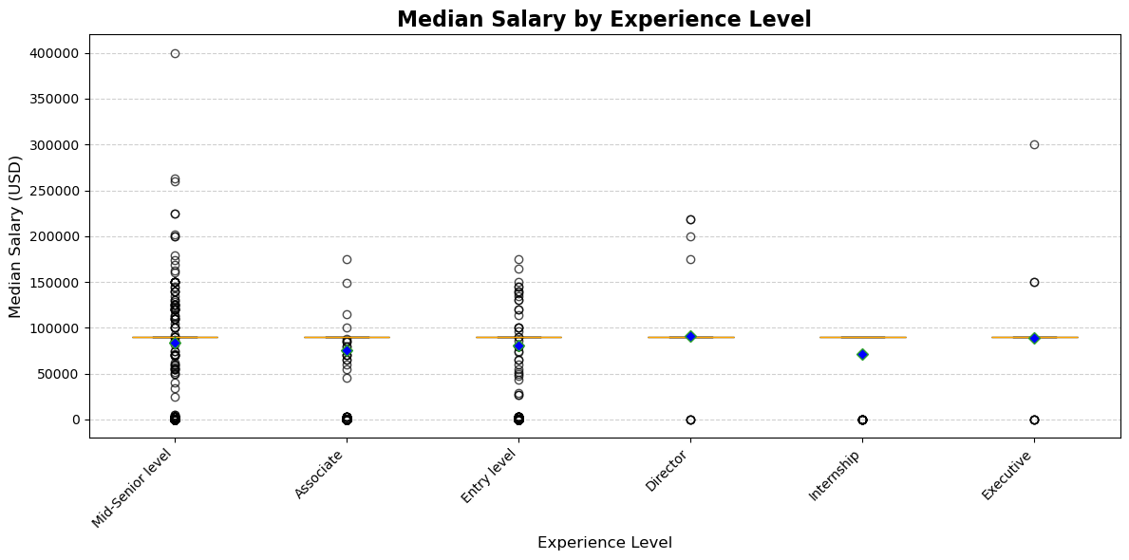
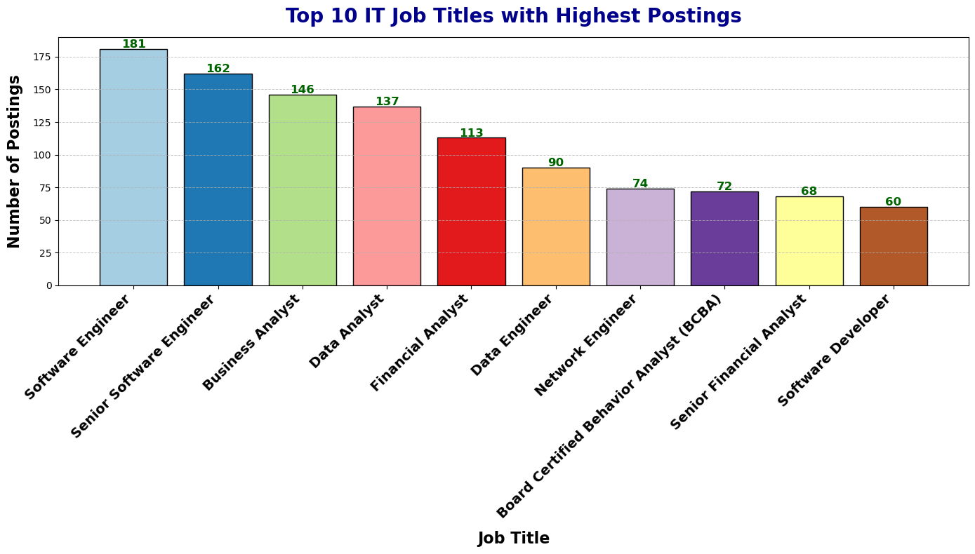
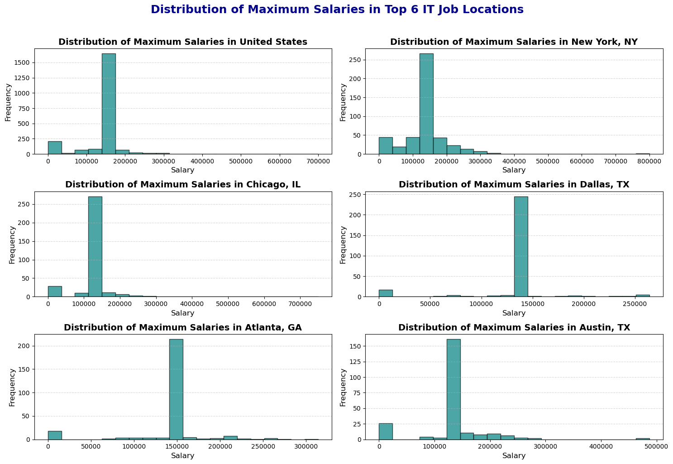
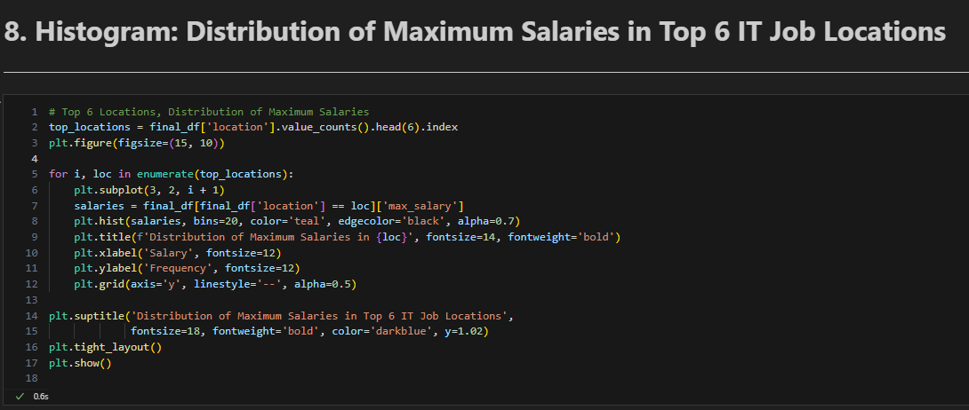
Data Visualisation: Boxplot, Bar Chart, Histogram
Box Plot
Purpose: Visualises median salary distribution across experience levels in IT jobs.
Key Insights: Median salaries rise with experience; Internship roles are lowest, Executive highest. Missing boxes indicate narrow data ranges.
Relevance: Supports research by showing salary trends across roles, aiding job seekers and employers.
Conclusion: Highlights salary expectations by experience for career planning and recruitment strategies.
The "box" in the box plot might not show up because my dataset is very big, and the salary data is packed closely together. This could make the range between the middle (Q1 and Q3) too small to see clearly. Also, too many data points or outliers might be covering the box, making it hard to spot.
Bar Plot
This chart highlights the top 10 IT job titles with the highest postings, with roles like Software Engineer and Business Analyst dominating demand. It provides valuable insights for job seekers to focus on in-demand roles and for educators to align training with market needs. By identifying hiring trends, it complements salary and skills analysis, showcasing the demand for specific positions. Overall, this chart aids in understanding the most sought-after roles, supporting career planning and workforce development.
Histogram
This analysis highlights the distribution of maximum salaries in the top 6 IT job locations, showcasing salary variability and identifying regions with the highest earnings, such as New York and Chicago. It addresses my research question by revealing how salaries differ by location, providing insights into hiring trends and regional compensation differences. This helps job seekers focus on high-paying areas and supports employers in setting competitive salaries.

Slide 15


Conclusions To Research Question
The truth awaits… Conclusions to my research question!

Slide 16
Steps Taken to Answer the Research Question
1. Data Preparation (Pandas)
Imported and cleaned datasets from the "CA1 dataset folder" using Pandas.
Conducted Exploratory Data Analysis (EDA) to understand the structure and key attributes of each dataset. This helped me gain clarity before merging.
Merged datasets to ensure all information was consistent and complete.
2. Handling Missing Data (Imputation & Dropping)
Addressed missing values by:
Imputing with medians for numerical columns (e.g., salaries and views).
Dropping columns or rows with excessive missing data and keeping those that are relevant
Ensured clean, reliable data for analysis.
4. Data Visualisation (Matplotlib)
Used Matplotlib to create detailed charts and plots:
Bar Charts for top IT roles and job locations.
Pie Chart for most in-demand IT skills.
Box Plots for salary distributions by experience level.
Histograms for maximum salary distribution by location.
Scatter Plot for the relationship between job views and applications.
3. Outlier Detection
Analysed key numerical columns like views and applies to identify extreme values using the IQR method.
Outliers were values outside Q1 - 1.5*IQR or Q3 + 1.5*IQR.
Applied capping to replace values beyond these bounds with the nearest limit.
Ensured a clean, reliable dataset by minimising the impact of extreme values on insights.

Slide 17
Final Conclusions
1. Hiring Trends
Top IT Job Titles:
Software Engineer is the most in-demand role with 181 postings.
Senior positions like Senior Software Engineer show high demand for experienced professionals.
Conclusion: Highlights the market's demand for skilled IT professionals, especially in software and business analysis roles.
2. Salary Ranges
Locations like Rye, NY offer the highest salaries (£175,000/year), with most IT job salaries ranging between £100k-£150k, accounting for over 11,000 postings. Salaries increase with seniority, with Directors earning £163,205 and Executives £153,649, while Entry-Level and Internship roles offer £110,000–£125,000. Overall, salaries vary significantly by experience and location, with seniority playing a key role in earning potential..
3. Required Skills
Top IT Skills:
Java (30.4%), SQL (26.1%), and Python (24.6%) dominate the market.
Cloud-related skills like AWS (15.9%) reflect growing demand for cloud technologies.
Conclusion: Job seekers should prioritise these skills to align with industry demand.
4. Experience Levels
Key Insights:
Mid-Senior Level: Salaries range from £90,000–£150,000 and represent a significant portion of postings.
Entry-Level Roles: Common, providing opportunities for fresh graduates.
Conclusion: Experience level greatly influences salary and job opportunities.
5. Work Types & Locations
Rye, NY, Long Beach, CA, and Boulder County, CO are top locations offering the highest salaries, often exceeding £120,000/year, reflecting the geographic concentration of IT hubs. The Histogram of Maximum Salaries by Location highlights significant salary variations across regions, emphasising the critical role of location in determining competitive compensation in the IT sector.

Slide 18
Thank You!
End Of CA1 Assignment : Done by Balamurugan Siddhartha (P2404312)

